Slide 1


SAP UI5 FIORI
JavaScript – Part A
www.zarantech.com
© Copyright 2021, ZaranTech LLC. All rights reserved.

Slide 2

Disclaimer
2
This presentation, including examples, images, and references are provided for informational purposes only.
Complying with all applicable copyrights laws is the responsibility of the user.
Without limiting the rights under copyright, no part of this document may be reproduced, stored or introduced into a retrieval system, or transmitted in any form or by any means.
Credits shall be given to the images taken from the open-source and cannot be used for promotional activities.

Slide 3
Agenda
3
Introduction to JavaScript
Statements and Comments
Finding Errors
Variables, Data Types
Operators
Strings
Events
Functions, Functions with Parameters
Functional with Multiple Parameters
Variable scope

Slide 4
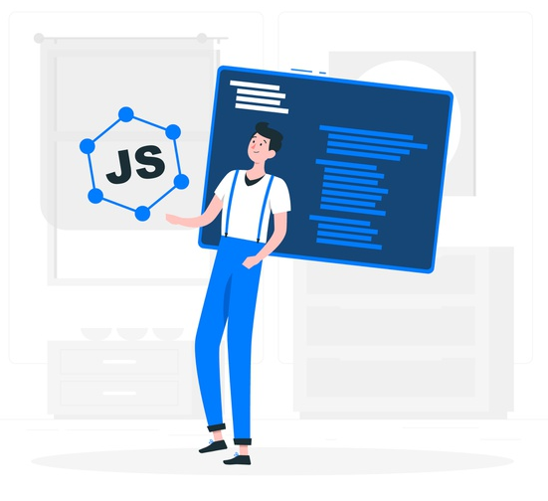
JavaScript
2
Introduction to JavaScript
JavaScript is the world's most popular programming language.
JavaScript is the programming language of the Web.
JavaScript is a lightweight, interpreted programming language.
It is designed for creating network-centric applications.
‹#›

Slide 5
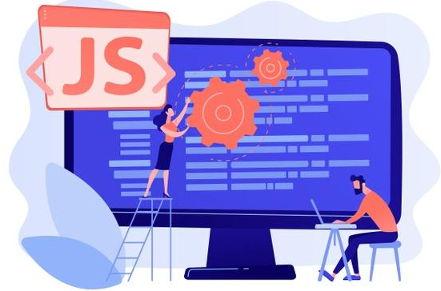
JavaScript
2
Why JavaScript?
JavaScript is one of the 3 languages all web developers must learn:
1. HTML to define the content of web pages
2. CSS to specify the layout of web pages
3. JavaScript to program the behavior of web pages
5

Slide 6
JavaScript
2
Why Learn JavaScript?
Most popular programming language in the world and that makes it a programmer’s great choice.
It is everywhere, comes installed on every modern web browser.
Helps you create really beautiful and crazy fast websites.
Extended to mobile app development, desktop app development, and game development.
6

Slide 7
JavaScript
2
JavaScript Features
All popular web browsers support JavaScript as they provide built-in execution environments.
Follows the syntax and structure of the C programming.
Weakly typed language, certain types are implicitly cast.
OOPS language uses prototypes rather than inherit classes.
Light-weighted and interpreted language.
Case-sensitive language.
Supportable in several operating systems including, Windows, Mac, etc.
7

Slide 8
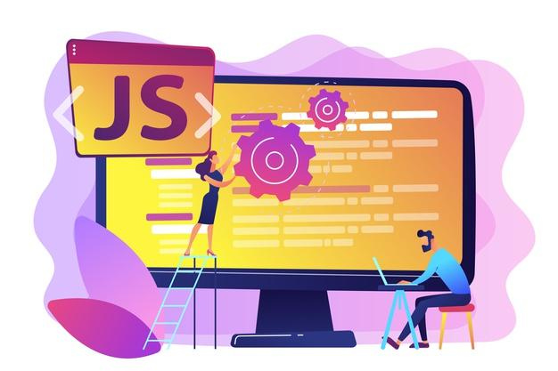
JavaScript
2
JavaScript Applications
Client-side validation,
Dynamic drop-down menus,
Displaying date and time,
Displaying pop-up windows and dialog boxes (like an alert dialog box, confirm dialog box and prompt dialog box),
Displaying clocks etc.
8

Slide 9
JavaScript
2
JavaScript Advantages
Less Server Interaction
Immediate feedback to the visitors
Increased Interactivity
Richer Interfaces
9

Slide 10
JavaScript
2
JavaScript Statements
JavaScript statements are composed of Values, Operators, Expressions, Keywords, and Comments.
For Example: document.getElementById("demo").innerHTML = "Hello Participants.";
Most JavaScript programs contain many JavaScript statements.
The statements are executed, one by one, in the same order as they are written.
JavaScript programs (and JavaScript statements) are often called JavaScript code.
‹#›

Slide 11
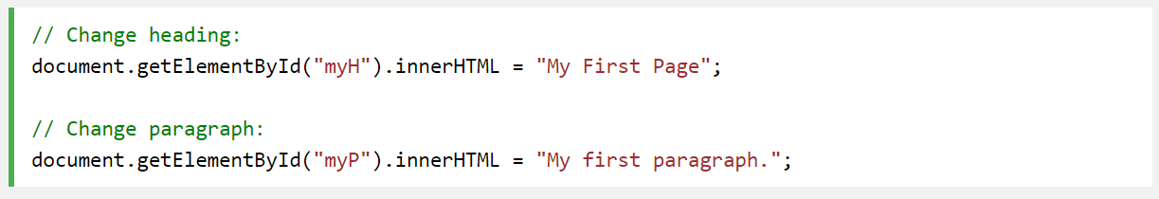
JavaScript
2
JavaScript Comments
Used to explain JavaScript code, and to make it more readable.
Used to prevent execution, when testing alternative code.
Single line comments start with //.
‹#›

Slide 12
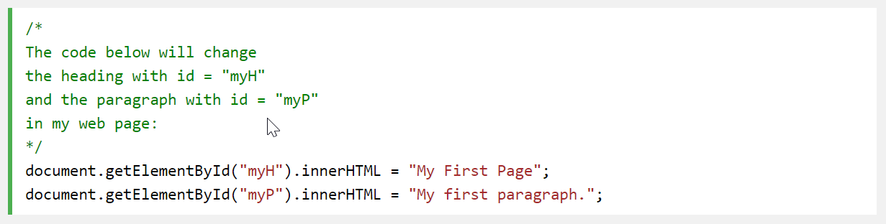
JavaScript
2
JavaScript Comments
Multi-line comments start with /* and end with */.
‹#›

Slide 13
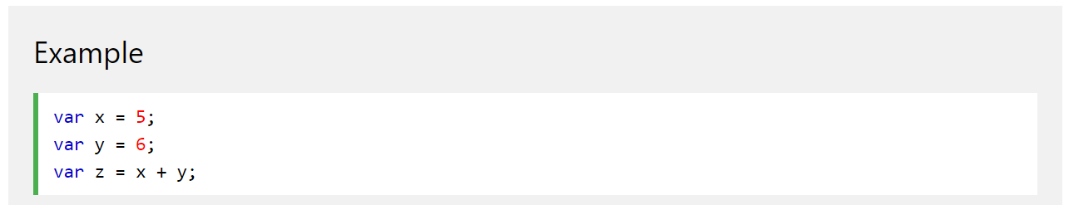
JavaScript
2
Variables
JavaScript variables are containers for storing data values.
In this example, x, y, and z, are variables, declared with the var keyword:
‹#›

Slide 14
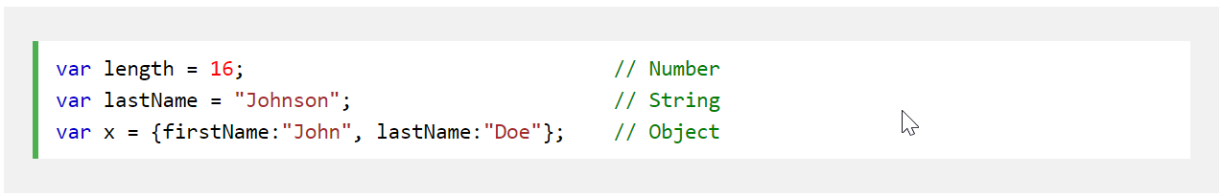
JavaScript
2
Data Types
JavaScript variables can hold many data types: numbers, strings, & objects.
In programming, data types is an important concept.
To be able to operate on variables, it is important to know something about the type.
‹#›

Slide 15
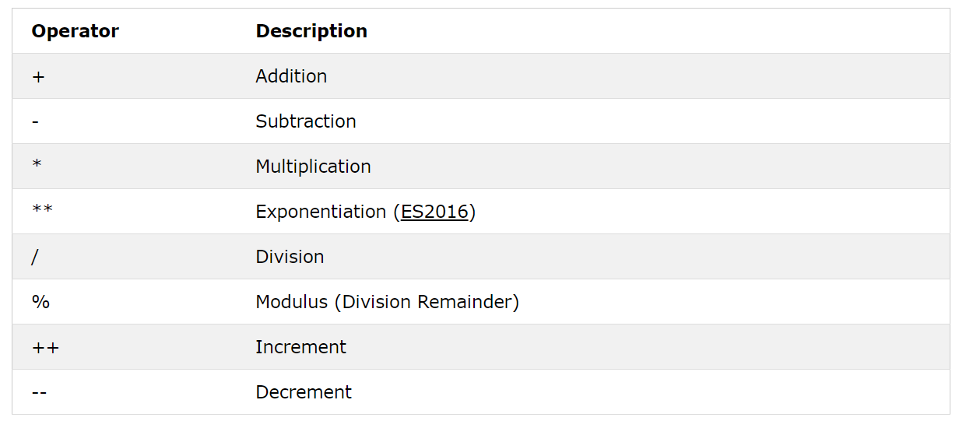
JavaScript
2
Operators - Arithmetic
‹#›

Slide 16
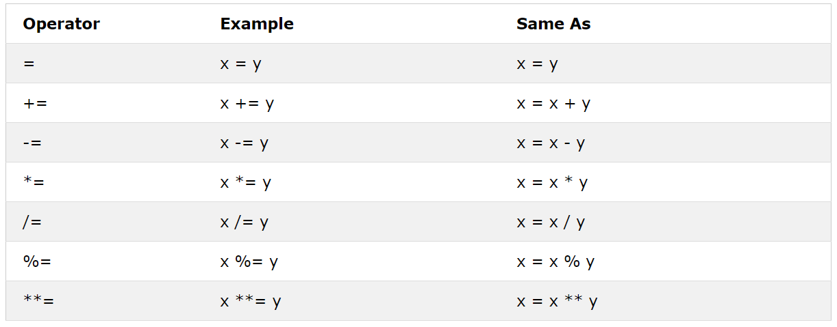
JavaScript
2
Operators - Assignment
‹#›

Slide 17
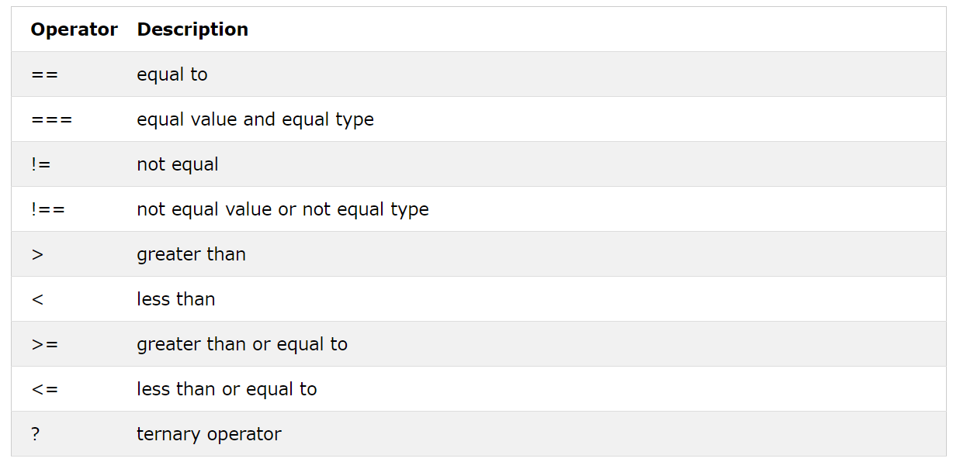
JavaScript
2
Operators - Comparison
‹#›

Slide 18
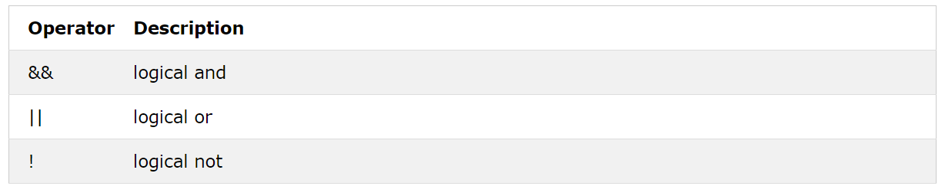
JavaScript
2
Operators - Logical
‹#›

Slide 19
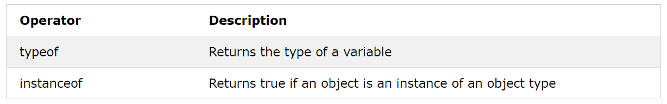
JavaScript
2
Operators - Type
‹#›

Slide 20
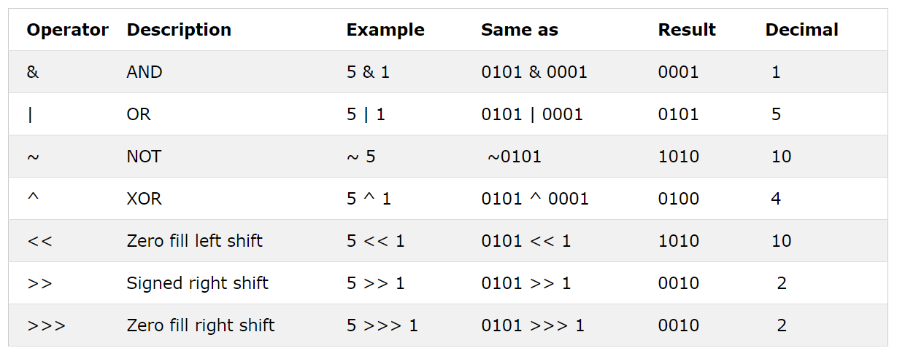
JavaScript
2
Operators - Bitwise
‹#›

Slide 21
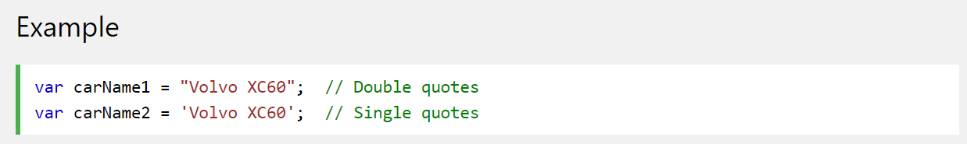
JavaScript
2
String
A JavaScript string is zero or more characters written inside quotes.
You can use single or double quotes:
‹#›

Slide 22
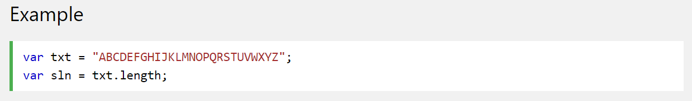
JavaScript
2
String
To find the length of a string, use the built-in length property:
‹#›

Slide 23
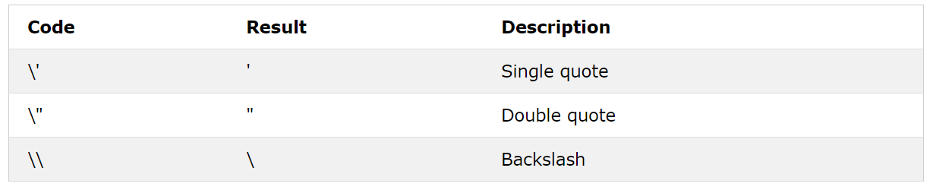
JavaScript
2
String
The backslash (\) escape character turns special characters into string characters:
‹#›

Slide 24
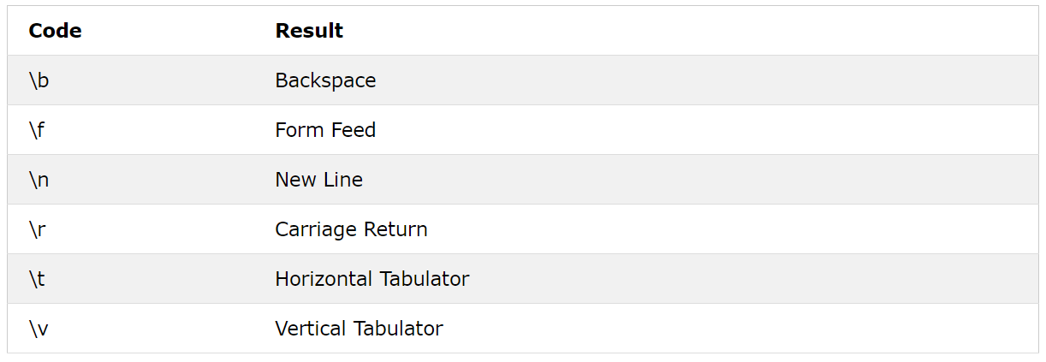
JavaScript
2
String
Six other escape sequences are valid in JavaScript:
‹#›

Slide 25
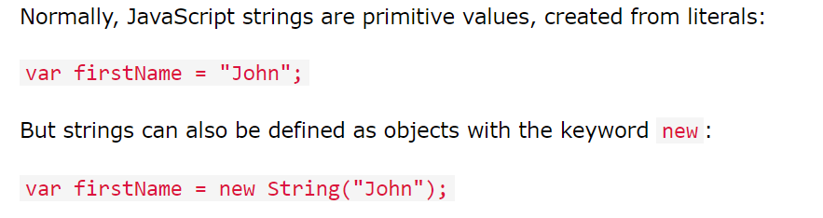
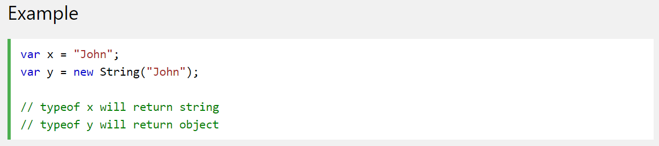
JavaScript
2
Strings can be Objects
‹#›

Slide 26
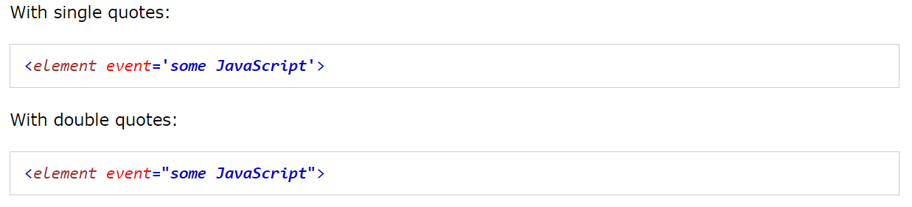
JavaScript
2
Events
HTML events are "things" that happen to HTML elements.
When JavaScript is used in HTML pages, JavaScript can "react" on these events.
An HTML event can be something the browser does, or something a user does.
HTML allows event handler attributes, with JavaScript code, to be added to HTML elements.
‹#›

Slide 27
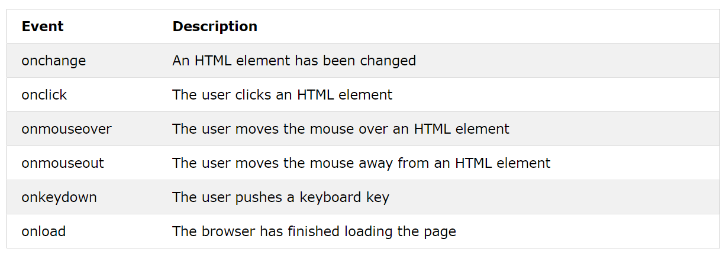
JavaScript
2
Common HTML Events
‹#›

Slide 28
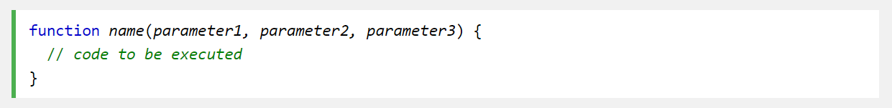
JavaScript
2
Functions
A JavaScript function is a block of code designed to perform a particular task.
A JavaScript function is defined with the function keyword, followed by a name, followed by parentheses ().
Function names can contain letters, digits, underscores, and dollar signs (same rules as variables).
‹#›

Slide 29
JavaScript
2
Functions
A Function is much the same as a Procedure or a Subroutine, in other programming languages.
Function parameters are listed inside the parentheses () in the function definition.
Function arguments are the values received by the function when it is invoked.
Inside the function, the arguments (the parameters) behave as local variables.
‹#›

Slide 30
JavaScript
2
Function Invocation
The code inside the function will execute when "something" invokes (calls) the function:
When an event occurs (when a user clicks a button)
When it is invoked (called) from JavaScript code
Automatically (self invoked)
‹#›

Slide 31
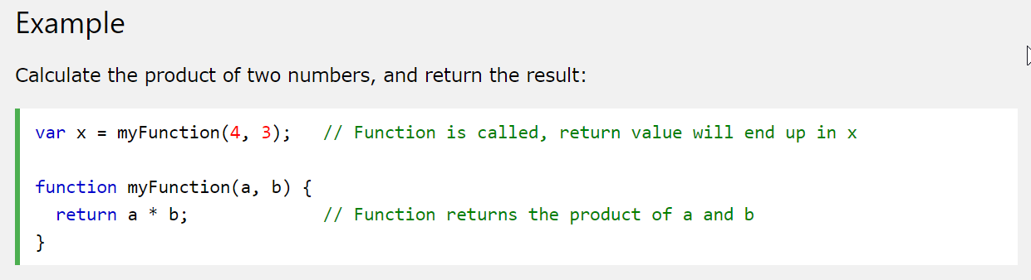
JavaScript
2
Function Return
When JavaScript reaches a return statement, the function will stop executing.
Functions often compute a return value. The return value is "returned" back to the "caller":
‹#›

Slide 32
JavaScript
2
Why Functions?
You can reuse code: Define the code once, and use it many times.
You can use the same code many times with different arguments, to produce different results.
‹#›

Slide 33
JavaScript
2
Finding HTML Elements by HTML Object Collections
HTML Object Collections are also accessible by:
HTML Object Collections
document.anchors
document.forms
document.images
document.links
document.scripts
‹#›

Slide 34
Thank you
Subscribe to our Channel for more Informative Videos.
https://www.youtube.com/user/ZaranTech

